Slide 1
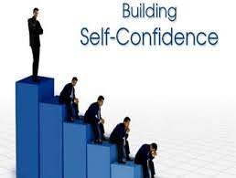
BUILD UP CONFIDENCE
By: Ramsha Bakht

Slide 2

What is self confidence
Self-confidence is the knowledge that you can do something and do it well .Self-confidence comes from first hand knowledge of the task at hand, knowing your strength and weakness , applying yours skills to any situation . Self-confidence is extremely important in almost every aspect of our lives.

Slide 3

Confident people
Celebrating other people’s success
Stay open - minded
Think positively
Willing to take risks
Able to laugh at themselves
Decisive
Always learning and growing
Admit mistakes
Accept responsibility

Slide 4
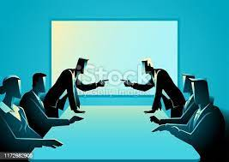
Insecure people
Judgment and jealous of others
Close – minded
Pessimistic
Fear change
Hide flaws
Indecisive
Act like a know – it – all
Always make excuses
Blame others
click here .https://www.google.com/search?q=business+fighting+people+gif&tbm=isch&hl=en&chips=q:business+fighting+people+gif,online_chips:arguing+conflict:2JO0NDm7xgE%3D&rlz=1C1GCEA_enPK926PK926&sa=X&ved=2ahUKEwjDx9ry0oGAAxVBpicCHRAEAssQ4lYoBnoECAEQNg&biw=1263&bih=544#imgrc=aewx-4ORiyZRoMbusiness fighting people gif

Slide 5

Practice makes perfect
Practice makes a man perfect as it brings improvement which leads a man towards achieving excellence in a particular subject or field.
The practice is a very crucial thing we must develop it in our life.
The chance of mistakes reduce by practicing the work regularly.
Practice boots our confidence level.

Slide 6
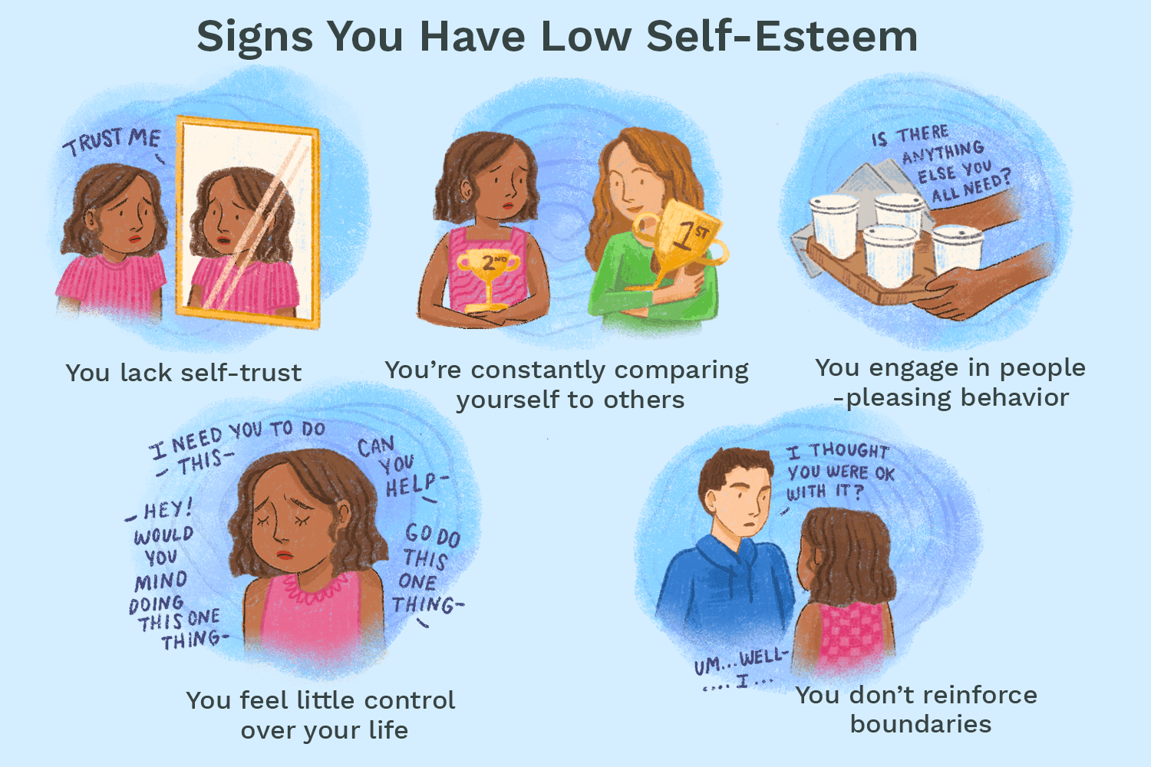

Slide 7
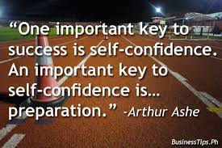


Slide 8
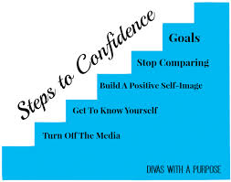

Slide 9
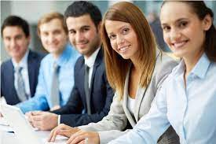
conclusion
Self-confidence is only an umbrella term for a lot of things. A self-confidence man also knows how to be heard with dignity, when there is a difference of opinion. …All this takes practice, but the most important thing is the belief that you can be better.

Slide 10
THANK YOU FOR YOUR PRICIOUS TIME

